Slide 1
The Mirrror Effect in SDT
Not another Recognition Memory study

Slide 2
One single problem…
Is that the sound of a predator approaching?
Is this food eatable?
Is my mom mad at me?
Does this patient have an Anxiety Disorder?
Is there a bomb in this bag?

Slide 3
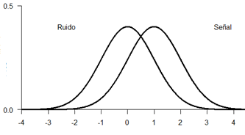
One single problem…
Is that the sound of a predator approaching?
Is this food eatable?
Is my mom mad at me?
Is there a bomb in this bag?
Noise
Signal
Is the target stimulus present?

Slide 4
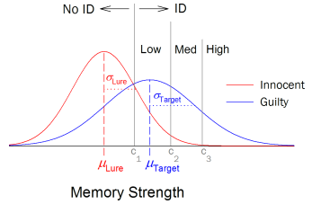
The Reliability of Eyewitness Identifications from Police Lineups
Wixted, Miickes, Dunn, Clark & Wells, 2016

Slide 5
Recognition Memory
Study phase
Recognition Task
Incidental
Intentional
Have I seen this stimulus before?

Slide 6
Procedures
1. Yes|No Task
Have you seen this stimulus before?
2. Confidence Rating
How confident are you about your answer?
0 | 1 | 2 | 3 | 4 | 5
HIGH New | MEDIUM New | LOW New | LOW Old | MEDIUM Old | HIGH Old

Slide 7
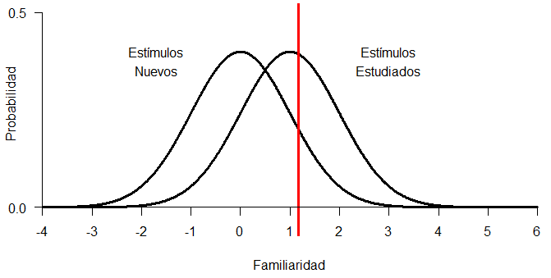
1. Yes|No Task
p(Hit)
p(False Alarm)

Slide 8
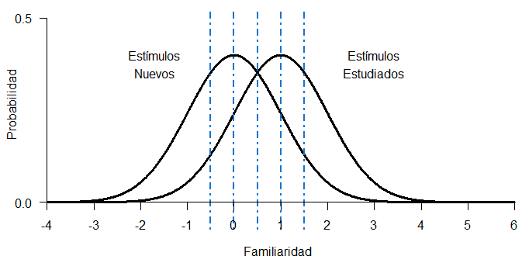
2. Confidence Rating
Sub-criteria
Confidence Criterion | p(Hit) | p(FA) | D’
Old-High |  |  | 1
Old-Medium |  |  | 1
Old-Low |  |  | 1
New-Low |  |  | 1
New-Medium |  |  | 1
New-High |  |  | 1

Slide 9
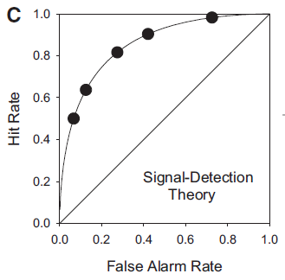

Slide 11
Mirror Effect
“If there are two classes of stimuli, and one is more accurately recogized than the other, then the superior class is both more accurately recognized as old when old and also more accurately recognized as new when new (…) means that the greater efficiency in recognizing is always twofold”
(Glanzer, Adams, 1990)

Slide 12
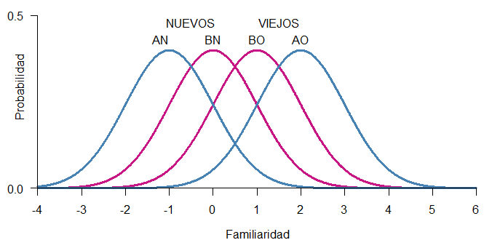
Mirror Effect
The greater efficiency in recognizing is always twofold.

Slide 13
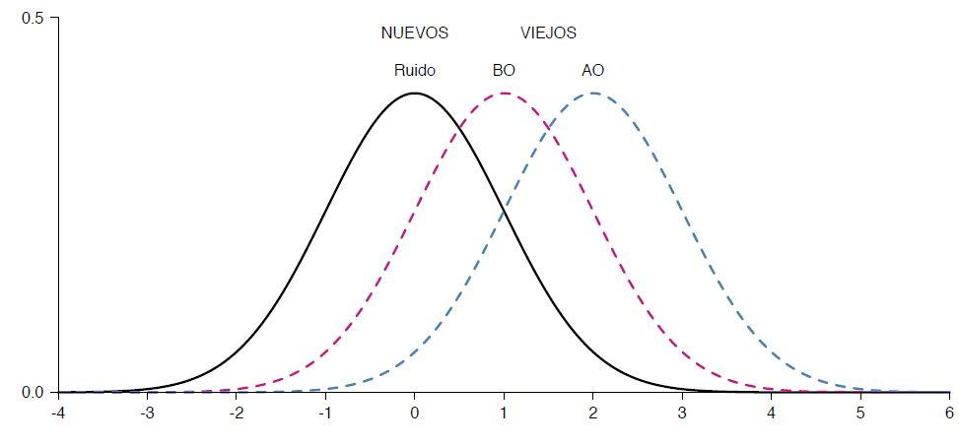

Slide 14


Evidence
Yes/No
Procedure
Rate
Confidence
Rating
Mean
2AFC: Preferences

Slide 15
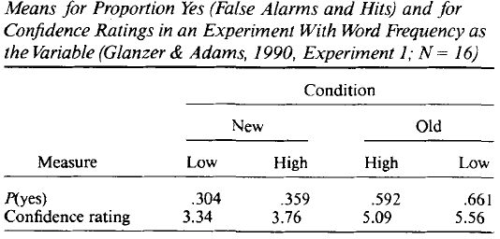
Example

Slide 16
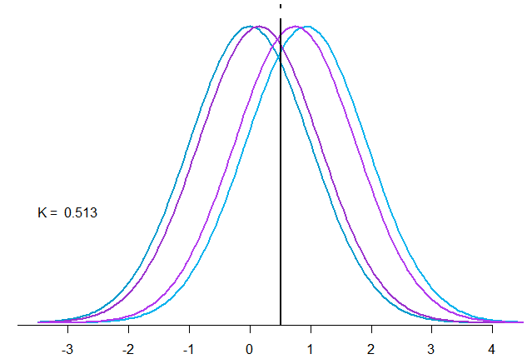
Example

Slide 17
Example

Slide 18
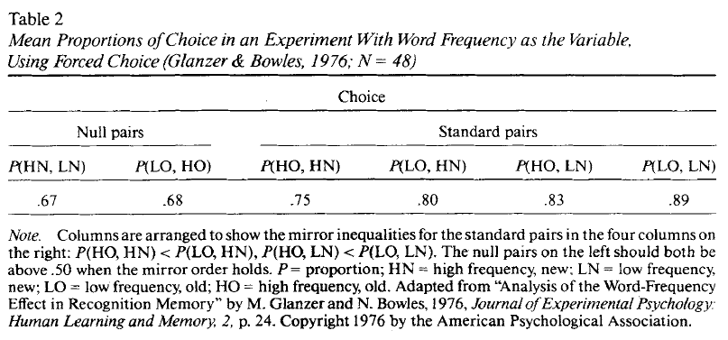
Ejemplo (Glanzer and Bowles, 1976)

Slide 19
2Alternative-ForcedChoice
Standard comparisons AO – AN - BN BO – AN - BN
Null Choices AN – BN AO - BO

Slide 20
Multiplicity
“The experimenter can produce as many separate mirror orders within a single data set as wished. All that has to be done is to impose effective variables factorially on the presented material and have a sufficient number of items in the study list.”
Extensiveness
“When two variables are used in a single experiment (…) produce an array of eight underlying distributions in mirror order”.

Slide 21

 |  | Frequency
 |  | Low | High
Concreteness | Concrete | LC | HC
 | Unconcrete | LU | HU

Slide 22
The Mirror Effect has only been studied within Recognition Memory.
Can we find the Mirror Effect in other areas where SDT has been applied?

Slide 23
Experiments

Slide 24
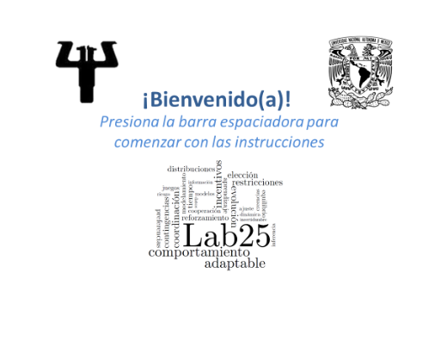

Slide 25
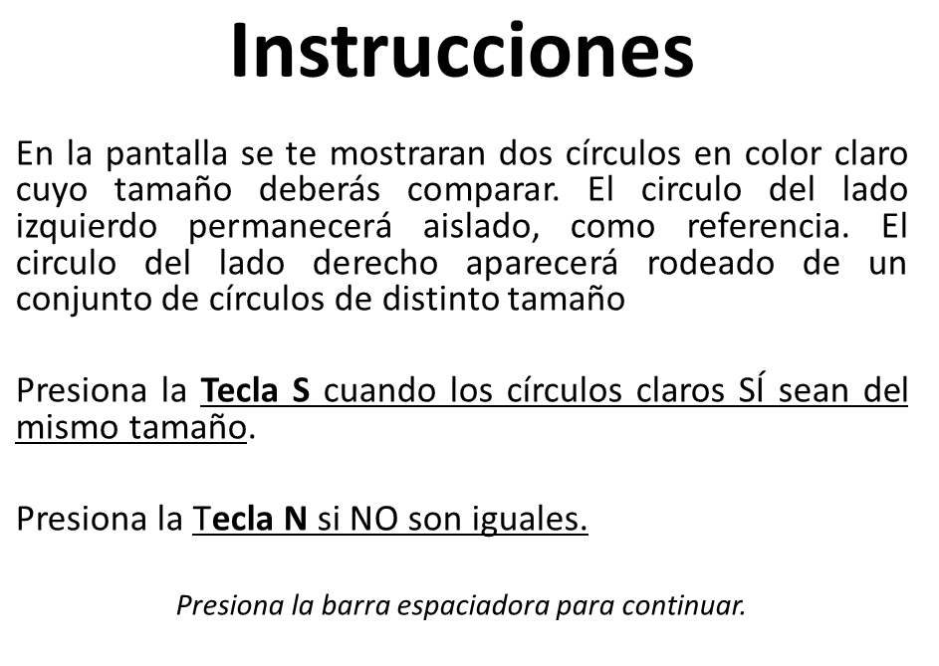

Slide 26
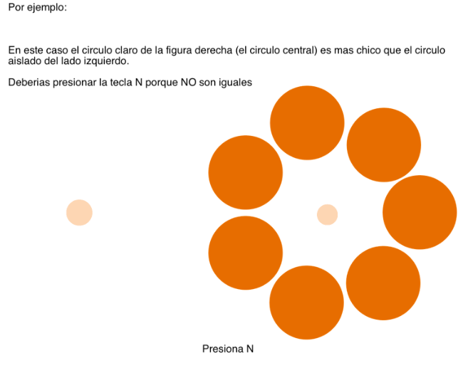

Slide 27
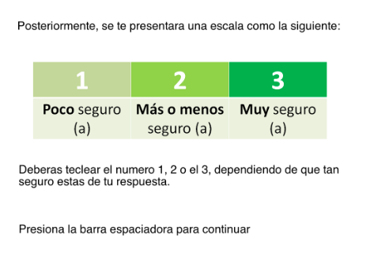

Slide 28
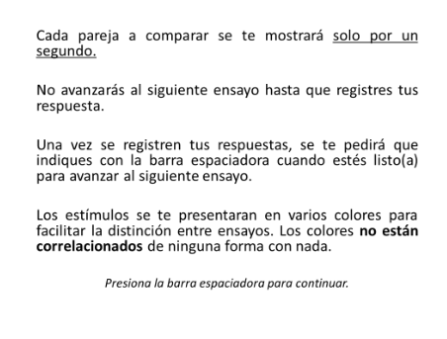

Slide 29
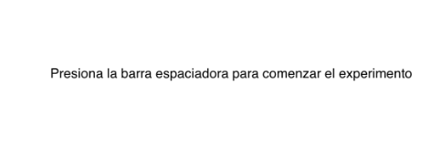

Slide 30
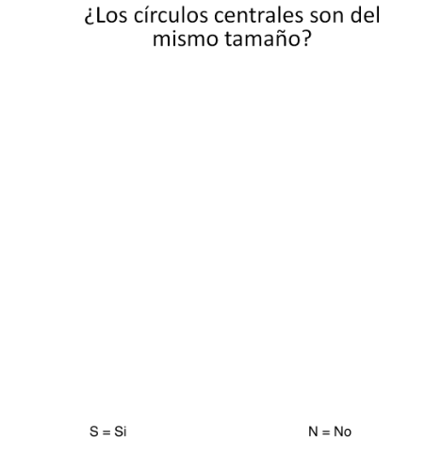
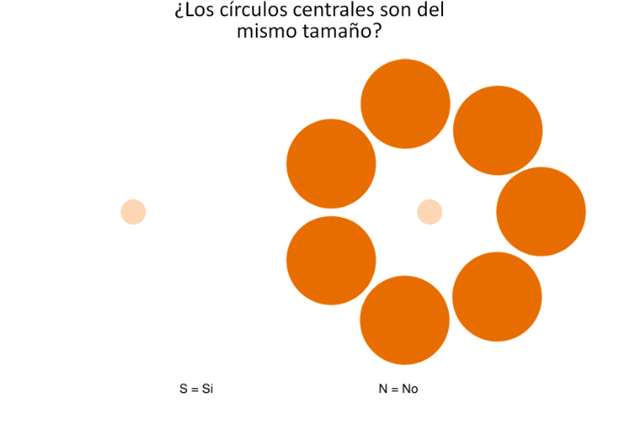

Slide 32
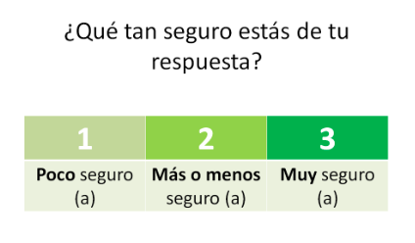

Slide 33
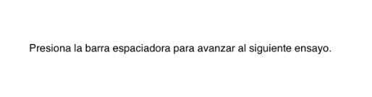

Slide 34
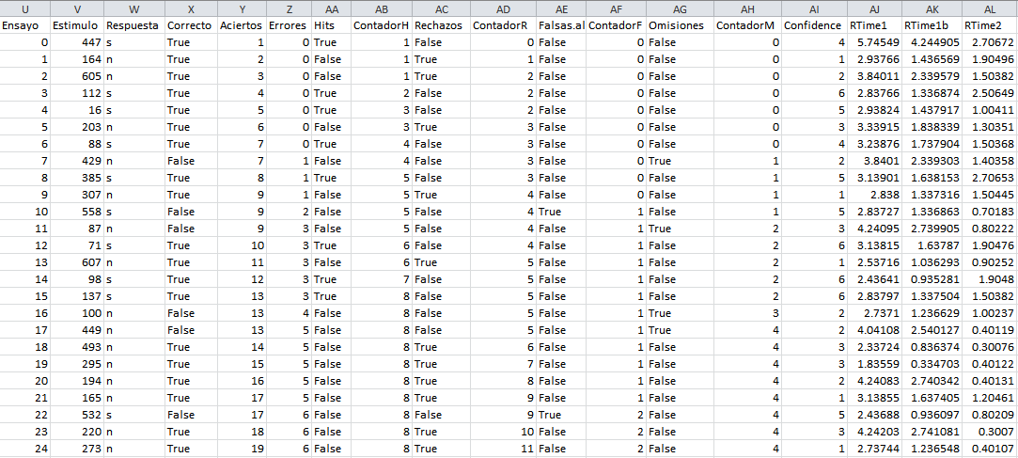

Slide 35
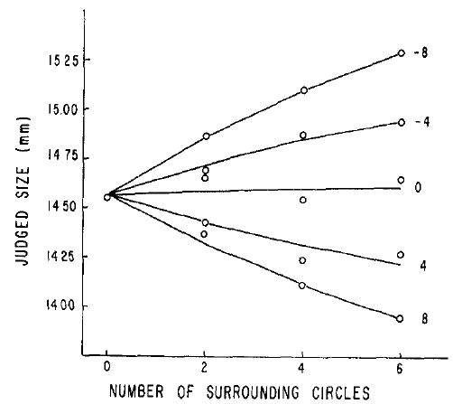
Looking for the Mirror Effect: A & B

Slide 36
Looking for the Mirror Effect: A & B
2 or 3 external circles
7 or 8 external circles
A
B

Slide 37
O
3
2
U
3
O
2
2.5
3
U
O
2
2
2
U
3
O
1.5
2
U
3
O
2
1
U
3

Slide 38
O
3
2
1 3
U
3
4
O
2
5 7
2.5
3
6 8
U
O
2
2
2
U
3
O
1.5
2
9 11
U
3
10 12
O
2
13 15
1
U
3
14 16

Slide 39
O
3
2
U
3
O
2
2.5
3
U
O
1, 2, 3, 4
9,10,11,12
2
2
2
U
3
5, 6, 7, 8
13, 14, 15, 16
O
1.5
2
U
3
O
2
1
U
3

Slide 40
O
3
7
U
8
O
7
2.5
8
U
O
2
2
7
U
8
O
1.5
7
U
8
O
7
1
U
8

Slide 41
A: Fewer External Circles
B: More external circles
16 pairs (signal)
16 pairs (noise)
32 trials
320 type A trials
16 pairs (signal)
16 pairs (noise)
32 trials
320 type B trials
64 trials
x10
5 different colors
2 per color
Counterbalancing

Slide 42
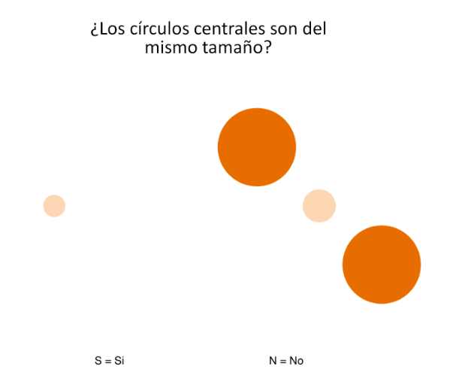

Slide 43
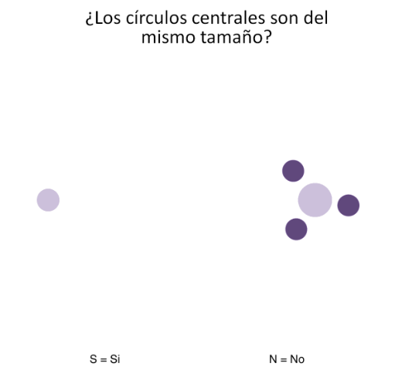

Slide 44
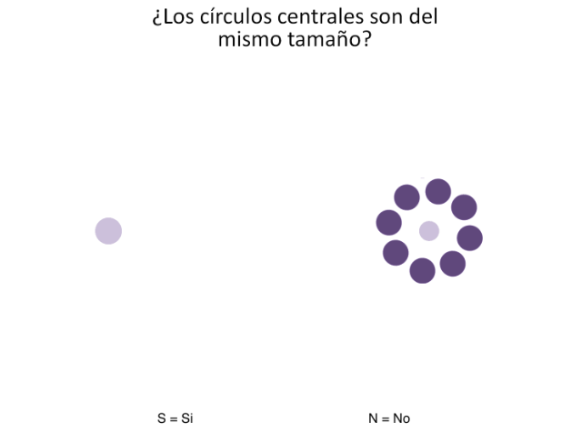

Slide 45
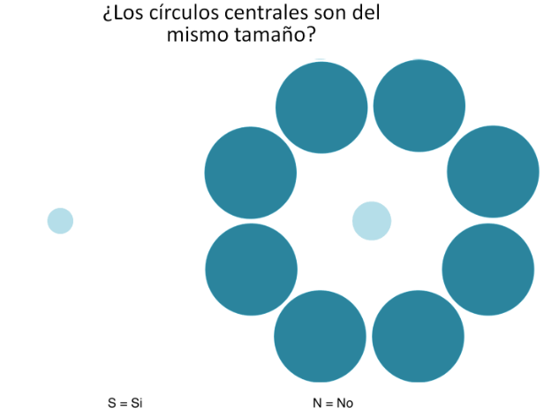

Slide 46
Two Experiments
Experiment 1:
Just one Ebbinghaus Illusion
Experiment 2:
Two Ebbinghaus Illusions
160 AS
160 AN
160 BS
160 BN
Same procedure
160 AS
160 AN
160 BS
160 BN
Same procedure

Slide 47
Data!
Individual cases

Slide 48
1st: Looking for Contaminants

Slide 49
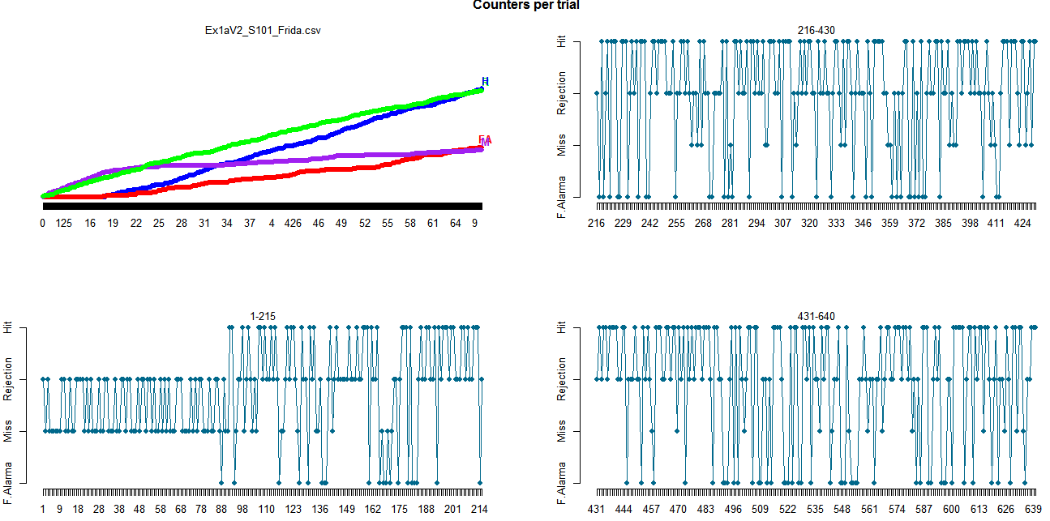
1st: Looking for Contaminants

Slide 50
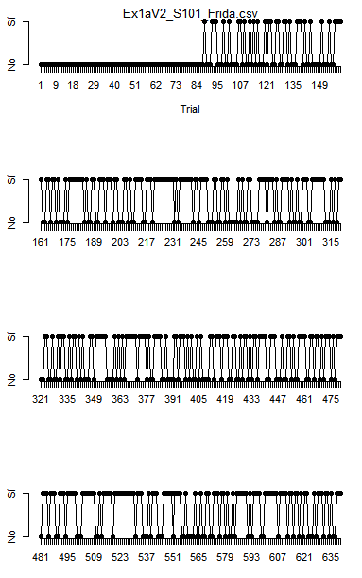

Slide 51
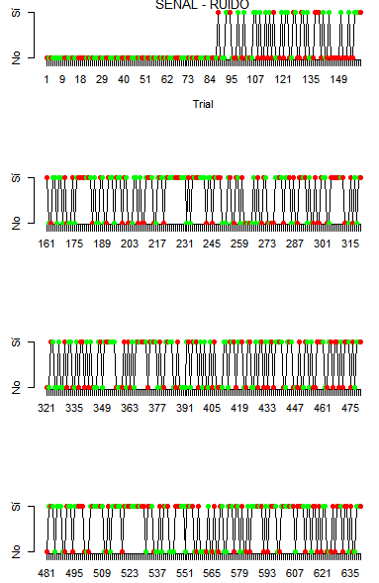
Signal - Noise

Slide 52
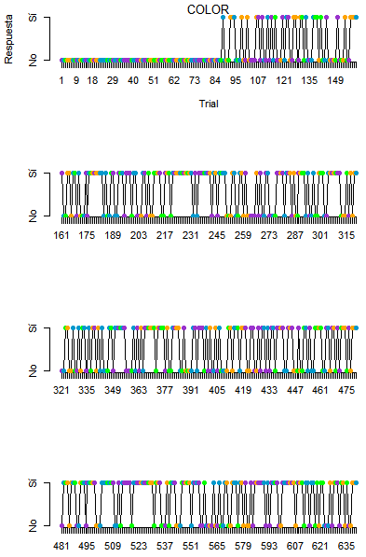

Slide 53
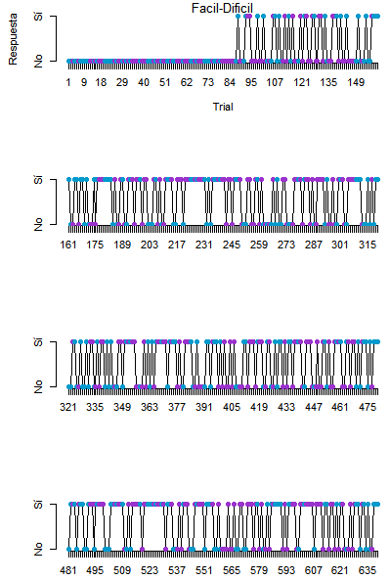

Slide 54
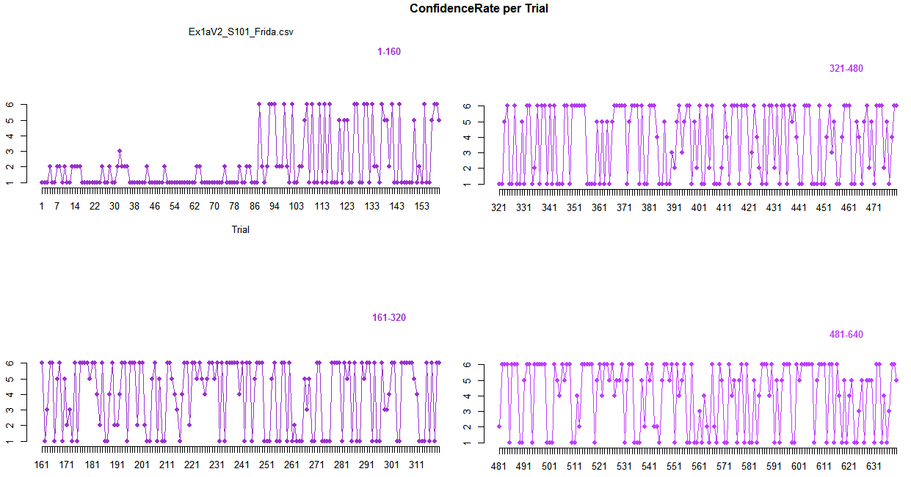

Slide 55
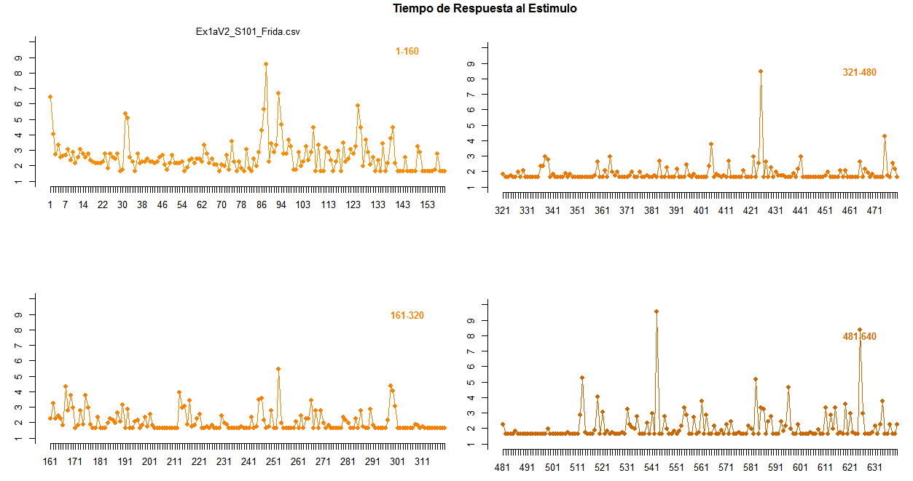

Slide 56
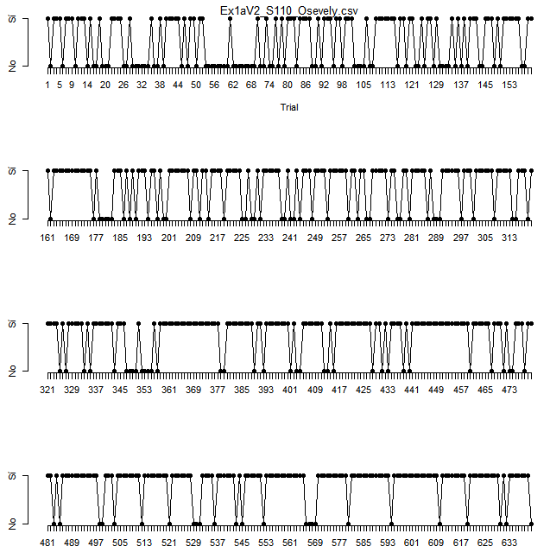
1st Problem: How do I know if a participant was actually paying attention?

Slide 57
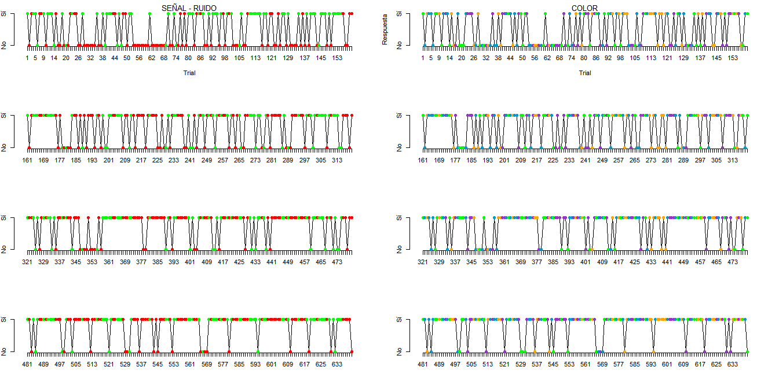

Slide 58
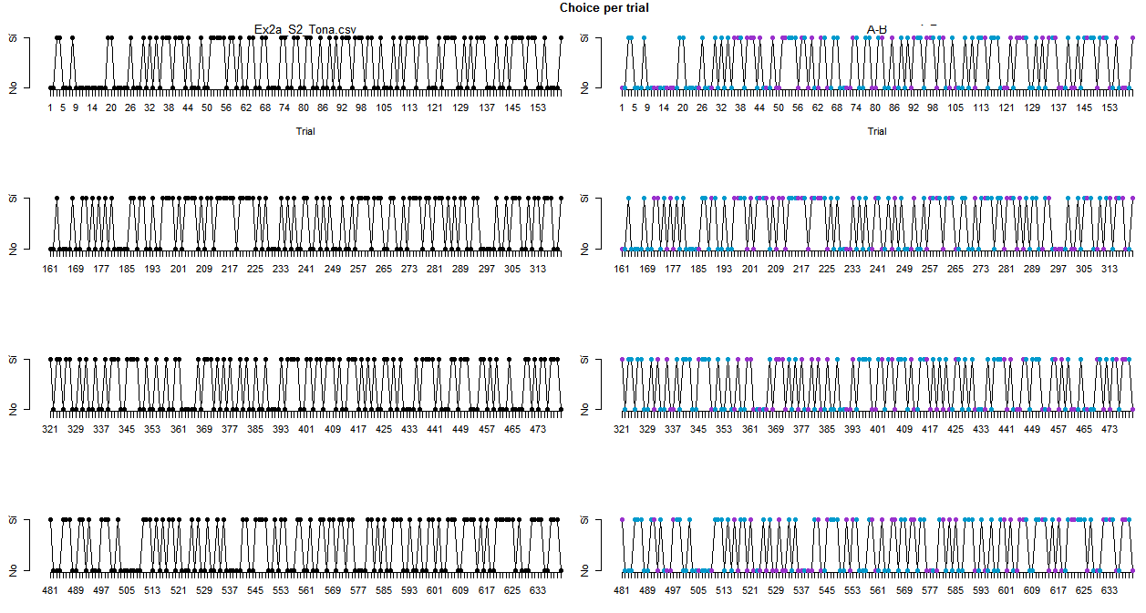

Slide 59
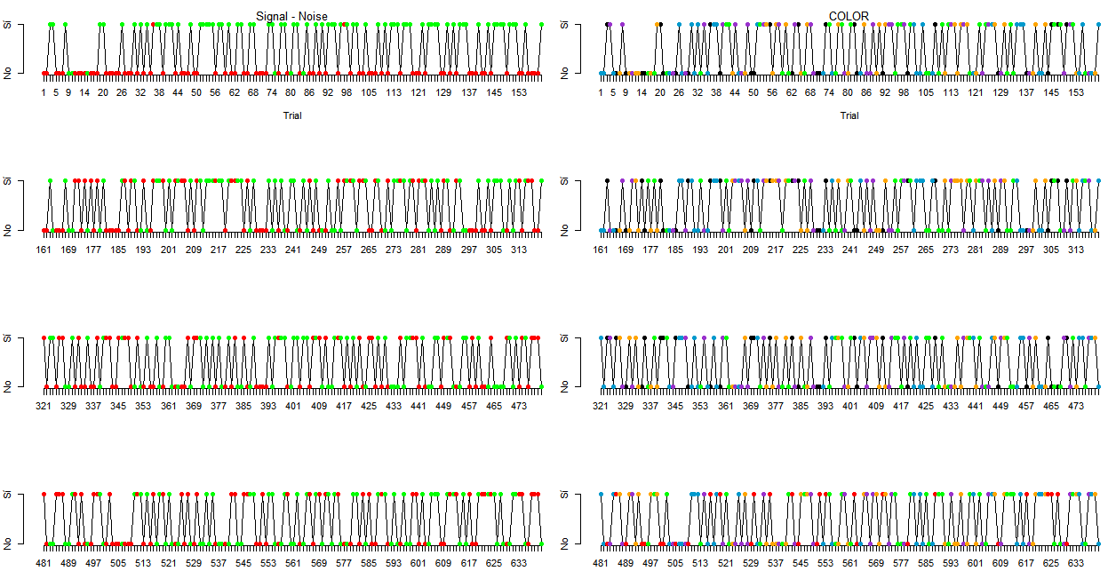

Slide 60
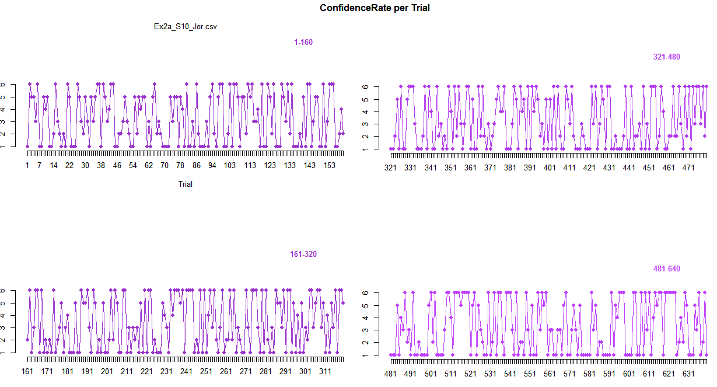
Confidence Rating

Slide 61
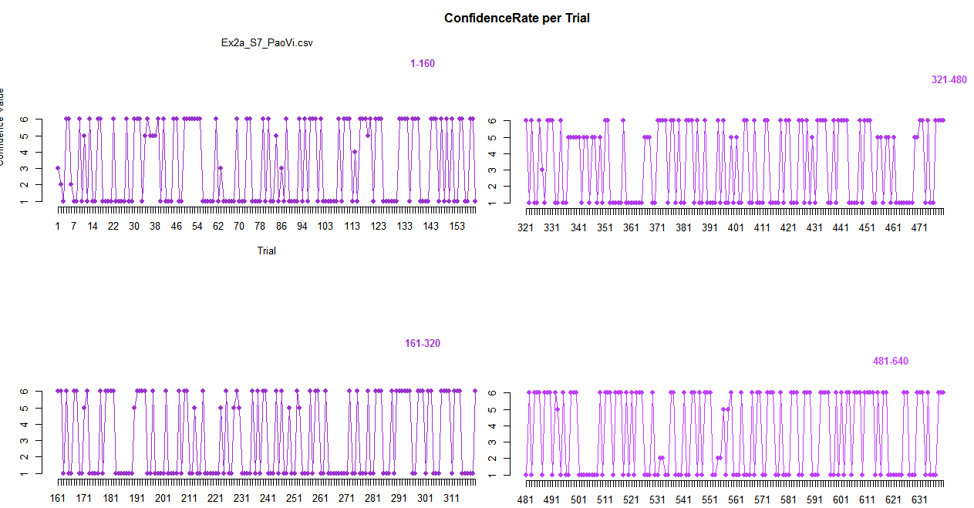
Confidence Rating

Slide 62
2nd: Exploring Sequential effects

Slide 63
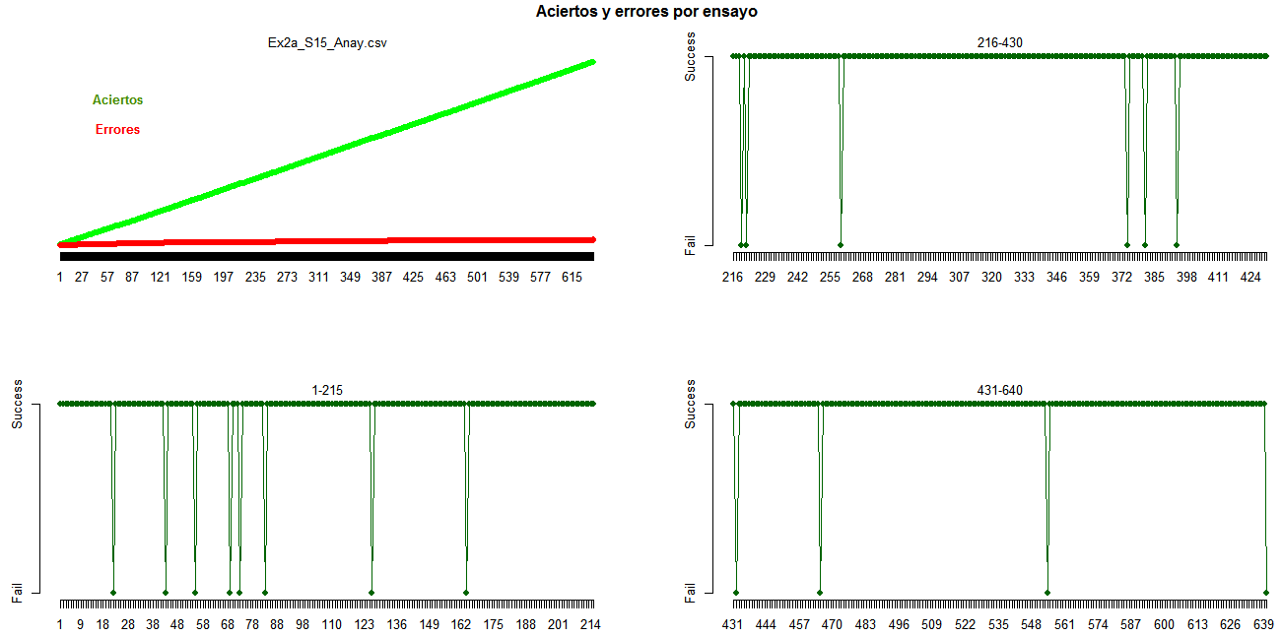
2nd: Exploring Sequential effects

Slide 64
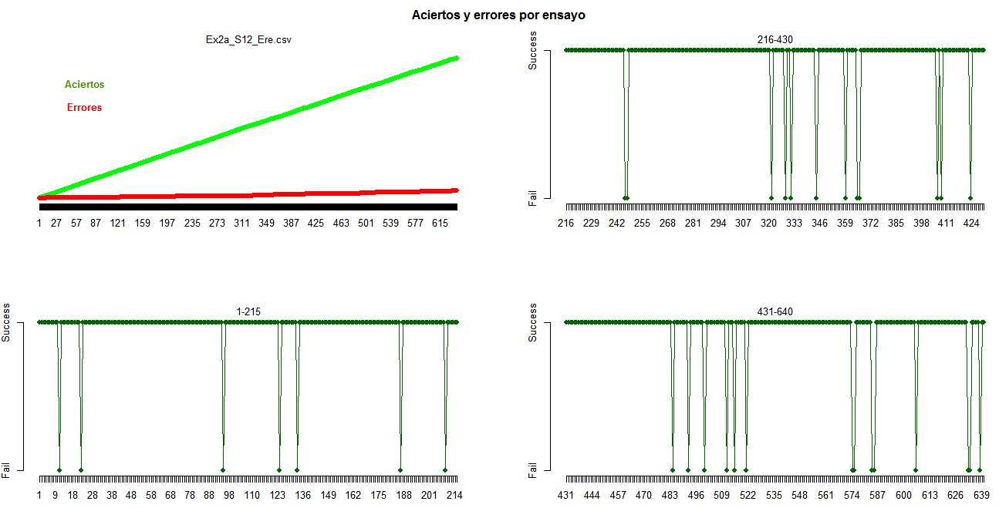

Slide 65
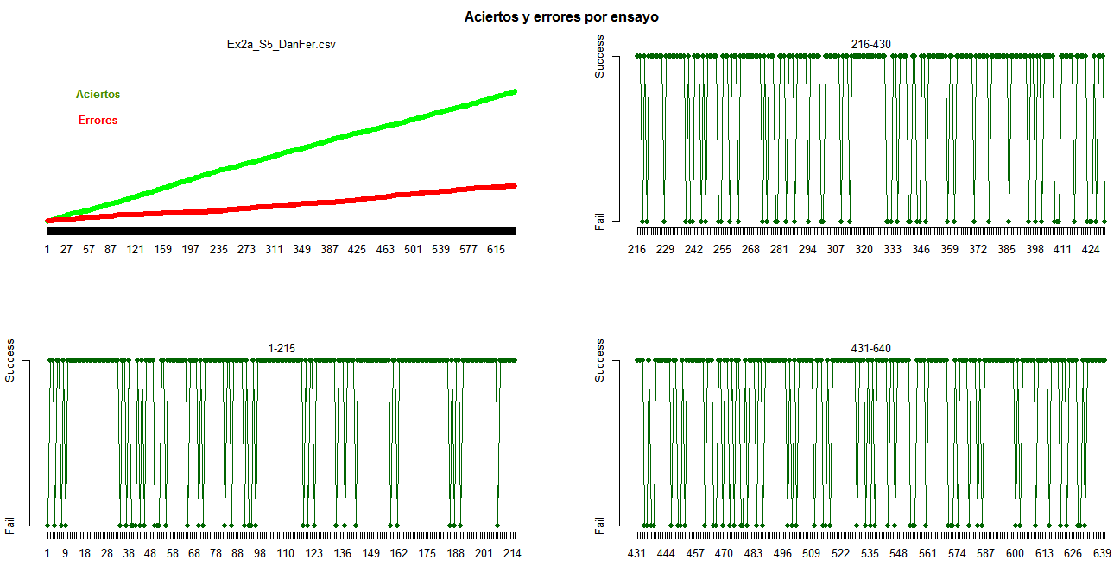

Slide 66
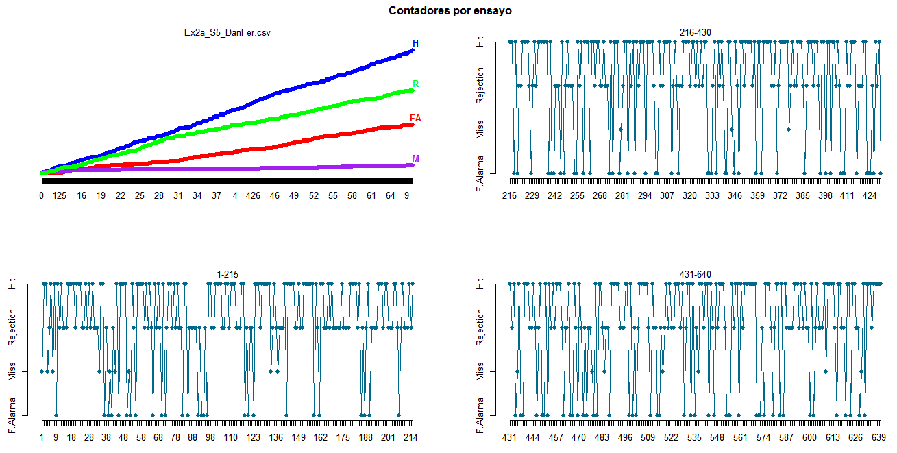

Slide 67
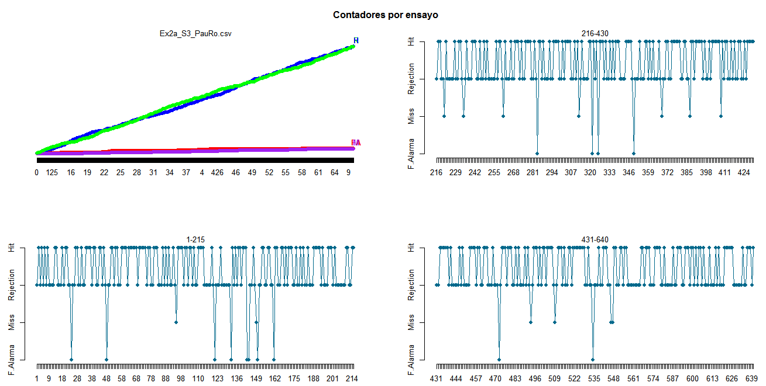

Slide 68
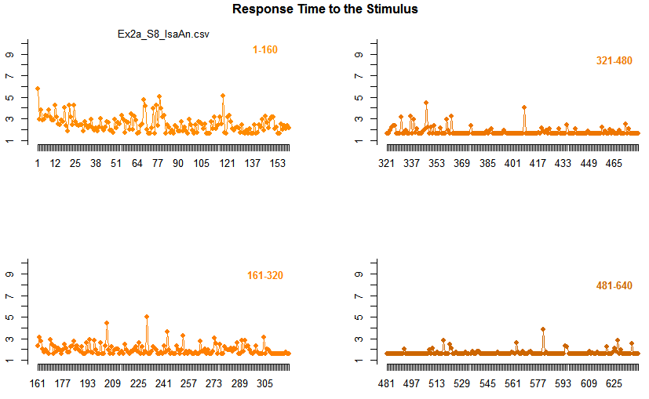

Slide 69
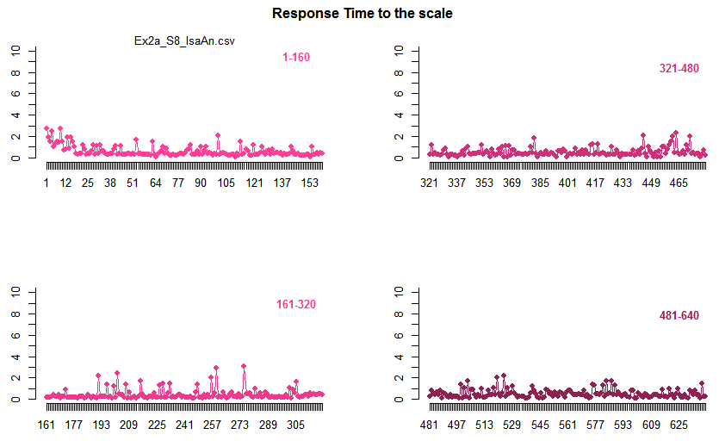

Slide 70
3rd: Exploring Correlations!

Slide 71
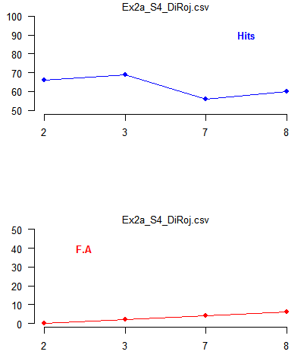
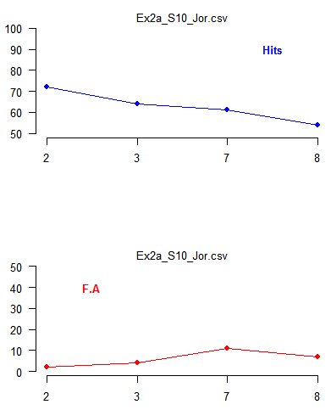
3rd: Exploring Correlations!

Slide 72
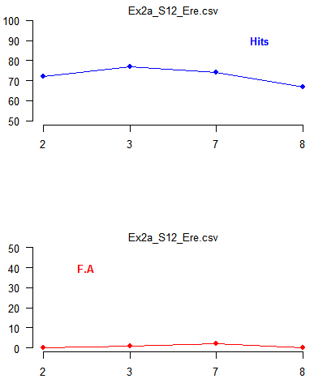
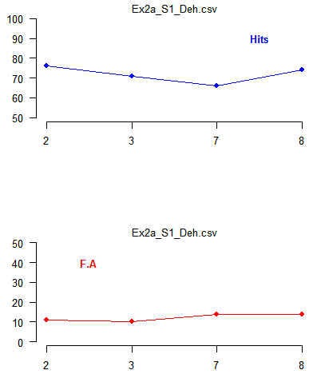

Slide 73



Slide 74



Slide 75



Slide 76
4th: Evaluating the pattern

Slide 77


4th: Evaluating the pattern

Slide 78



Slide 79



Slide 80



Slide 81


Ambiguity

Slide 82


Slide 83


Distributions!

Slide 84



Slide 85



Slide 86



